Slide 1


Mental Arithmetic 2- back page and write the date
1.
2.
3.
4.
5.

Slide 2
Time
EQ: How do I use 24 hour time? What are timezones and what do they mean to me?

Slide 3
24 hour time
Write notes that you need so you will know it!!
https://www.youtube.com/watch?v=2fYMRDZfrOI
One for the MEN!!
http://www.artofmanliness.com/2012/10/11/how-to-tell-time-like-a-soldier/

Slide 4
Practise time
Do your work sheets
2_converting 24hr clock times
2_converting 24hr time
You need to read your answers to a partner using past and to talk

Slide 5
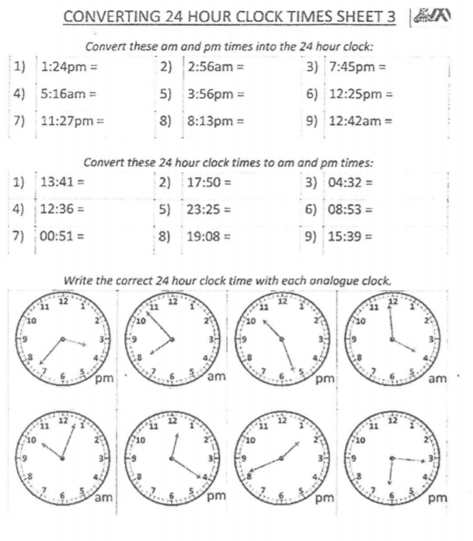

Slide 6
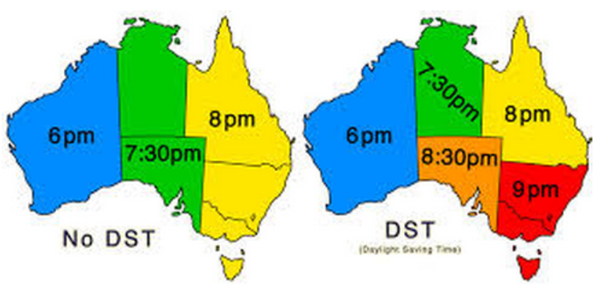
Time zones

Slide 7
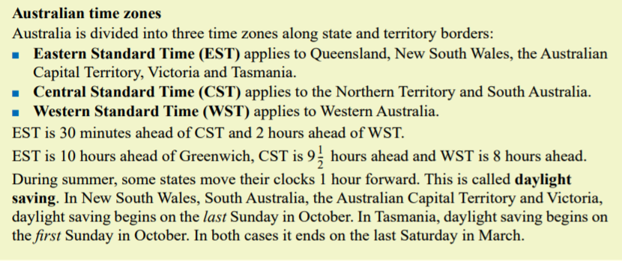

Slide 8
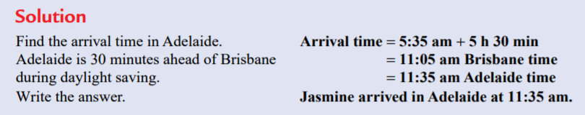
Example:

Slide 9
Complete 2_Australian time zone worksheet

